Slide 1
Statistical data analysis in R
Visiting professor
Viktor Ermakov

Slide 2
Lecture 9

Slide 3
Continuous distributions

Slide 4
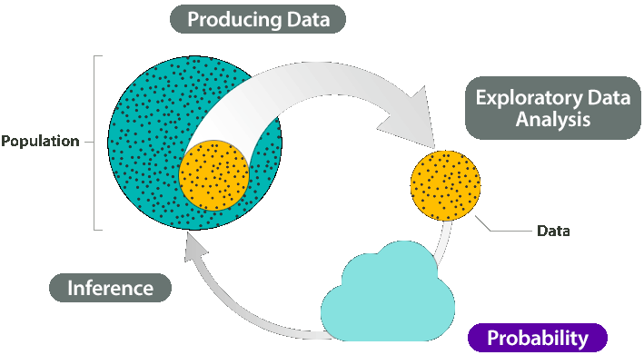
In this lecture
Probability Density Function
Cumulative Distribution Function
Expectation of continuous random variable
Continuous uniform distribution
Normal distribution
Some other continuous distributions
Distribution functions in R
Fitting distributions in R
Statistical data analysis in R. Viktor Ermakov – Visiting professor, UFSCar.

Slide 5
Probability Density Function
Sample space:
S_{X} = [a, b] or (a, b)
or in a case of a =-∞ and b=∞
S_{X} = (-∞, ∞)
Statistical data analysis in R. Viktor Ermakov – Visiting professor, UFSCar.

Slide 6
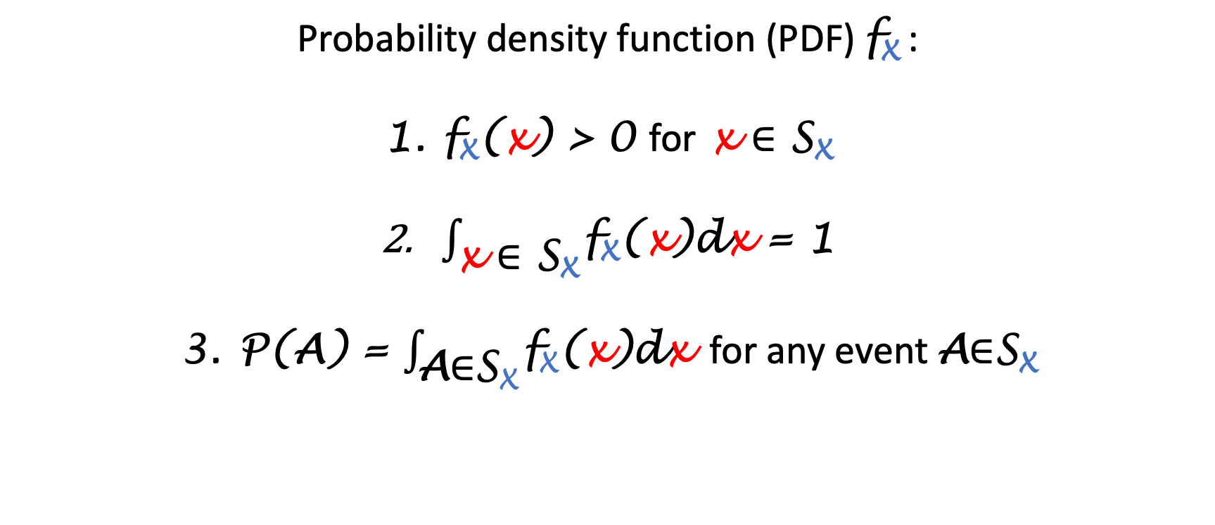
Probability Density Function
Probability density function (PDF) f_{X} :
f_{X}(x) > 0 for x ∈ S_{X}
$\int_{\text{x}\text{ ∈ }\text{S}\text{X}}^{ }{\text{f}\text{X}\text{(}\text{x}\text{)}\text{d}\text{x} \text{= 1}}$
P(A) = $\int_{\text{A}\text{∈}\text{SX}}^{ }{\text{f}\text{X}\text{(}\text{x}\text{)}\text{d}\text{x}}$ for any event A∈S_{X}
Statistical data analysis in R. Viktor Ermakov – Visiting professor, UFSCar.

Slide 7
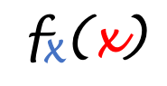
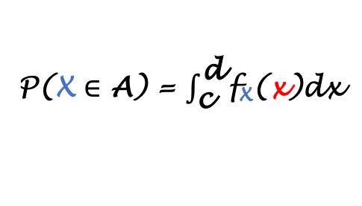
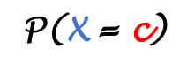
Probability Density Function
Usually event A = [c, d]
f_{X}(x)
0.2
2
P($\text{X}$ ∈ A) = $\int_{\text{c}}^{\text{d}}{\text{f}\text{X}\text{(}\text{x}\text{)}\text{dx}}$
$$\text{f}\text{X}\text{(}\text{x}\text{)}$$
can be >1
c
c d
0
1
8
9
x
0
2
4
5
0.8
0.2
3
0.4
6
0.6
7
P($\text{X}$= c)
= 0
Statistical data analysis in R. Viktor Ermakov – Visiting professor, UFSCar.

Slide 8

Cumulative Distribution Function
Cumulative Distribution Function (CDF)
F_{X}(t) = P(X≤t) = $\int_{\text{-∞}}^{\text{t}}{\text{f}\text{X}\text{(}\text{x}\text{)}}$dx, -∞ < t <∞
Statistical data analysis in R. Viktor Ermakov – Visiting professor, UFSCar.

Slide 9
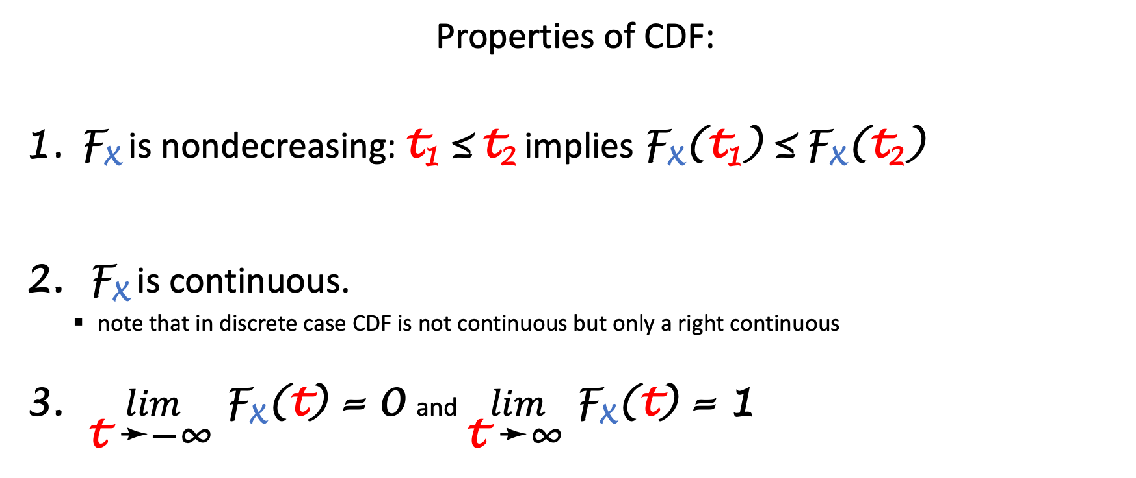
Cumulative Distribution Function
Properties of CDF:
F_{X} is nondecreasing: t₁ ≤ t₂ implies $\text{F}\text{X}\text{(}\text{t}\text{1}\text{)}$ ≤ $\text{F}\text{X}\text{(}\text{t}\text{2}\text{)}$
F_{X} is continuous.
note that in discrete case CDF is not continuous but only a right continuous
$\lim_{\text{t} \text{➛}\text{−∞} }{\text{F}\text{X}\text{(}\text{t}\text{)}}$ = 0 and$\lim_{\text{t} \text{➛}\text{∞} }{\text{F}\text{X}\text{(}\text{t}\text{)}}$ = 1
Statistical data analysis in R. Viktor Ermakov – Visiting professor, UFSCar.

Slide 10
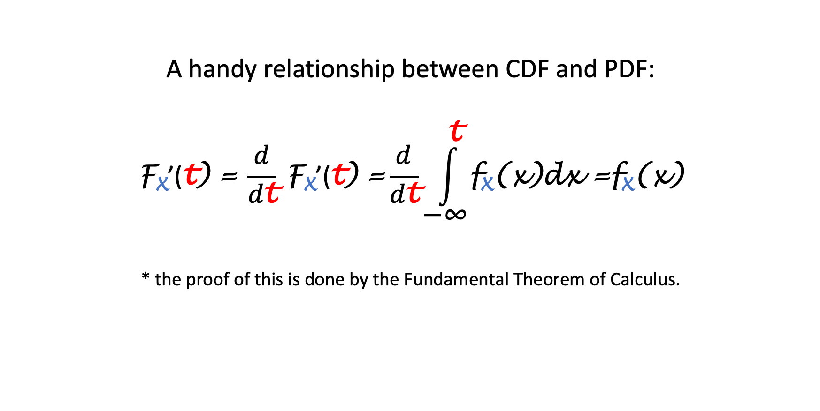
Cumulative Distribution Function
A handy relationship between CDF and PDF:
$$\text{F}\text{X}\text{’}\text{(}\text{t}\text{)}\text{ =} \frac{d}{d\text{t}} \text{F}\text{X}\text{’(}\text{t}\text{)}\text{ =}\frac{d}{d\text{t}}\int_{\text{−∞}}^{\text{t}}{\text{f}\text{X}\text{(}\text{x}\text{)}\text{dx}} \text{=}\text{f}\text{X}\text{(}\text{x}\text{)}$$
* the proof of this is done by the Fundamental Theorem of Calculus.
Statistical data analysis in R. Viktor Ermakov – Visiting professor, UFSCar.

Slide 11
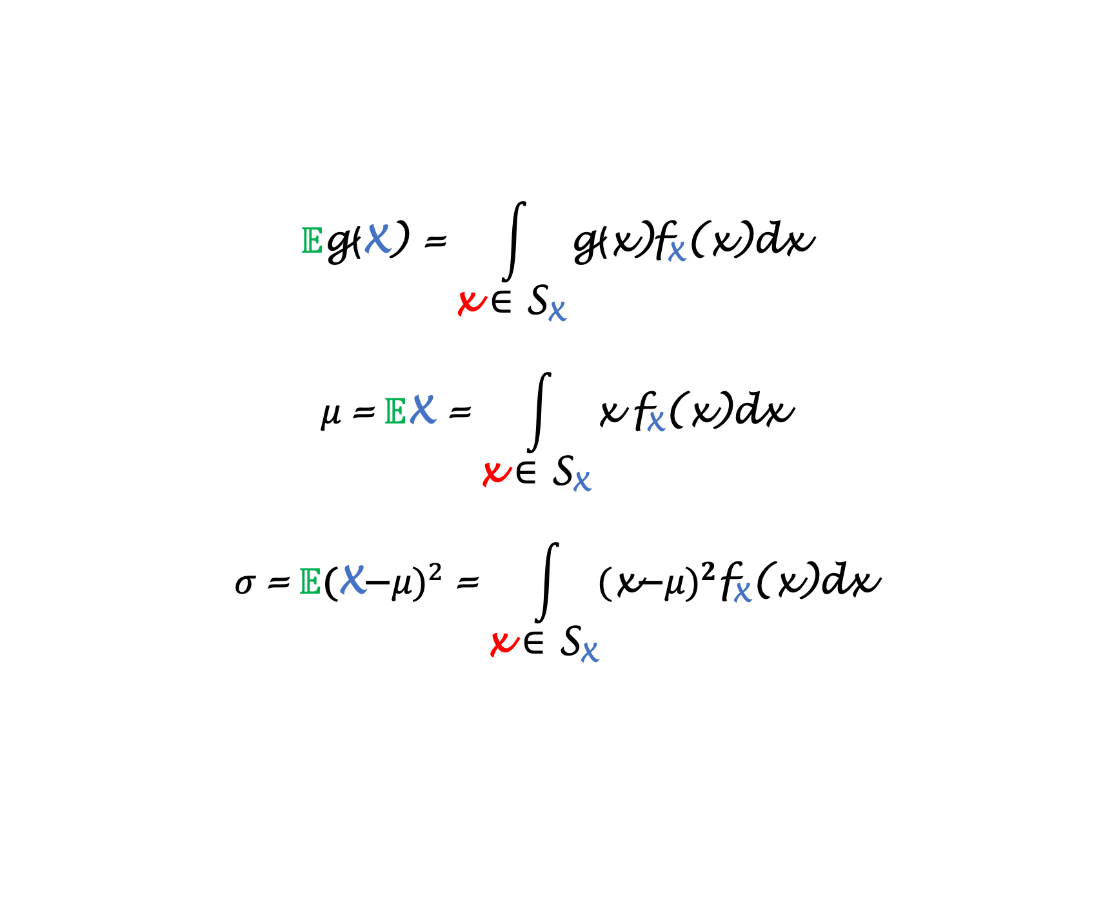
Expectation of Continuous Random Variables
$$𝔼\text{g}\text{(}\text{X}\text{) =}\int_{\text{x} \text{∈ }\text{S}\text{X}}{\text{g}\text{(}\text{x}\text{)}\text{f}\text{X}\text{(}\text{x}\text{)}\text{dx}}$$
$$μ \text{=} 𝔼\text{X}\text{ =}\int_{\text{x} \text{∈ }\text{S}\text{X}}{\text{x} \text{f}\text{X}\text{(}\text{x}\text{)}\text{dx}}$$
$$σ \text{=} 𝔼{\text{(}\text{X}\text{−}μ\text{)}}^{2} \text{=}\int_{\text{x} \text{∈ }\text{S}\text{X}}{{\text{(}\text{x}\text{−}μ\text{)}}^{2}\text{f}\text{X}\text{(}\text{x}\text{)}\text{dx}}$$
Statistical data analysis in R. Viktor Ermakov – Visiting professor, UFSCar.

Slide 12
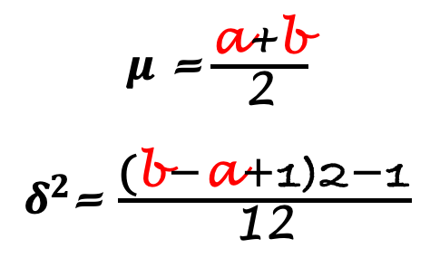

Continuous uniform distribution
f_{X}(x)
S_{X} = (a, b)
$\text{f}\text{X}\text{(}\text{x}\text{)}\text{=}\text{P}\text{(}\text{X}\text{ =}\text{x}\text{)=} \frac{\text{1}}{\text{b}\text{-}\text{a}}$ , for $\text{a}$<x <$\text{b}$
x
a
b
$μ$ =$\frac{\text{a}\text{+}\text{b}}{\text{2}}$
$δ^{2}$= $\frac{\text{(}\text{b}\text{−}\text{a}\text{+1)2−1}}{\text{12}}$
Statistical data analysis in R. Viktor Ermakov – Visiting professor, UFSCar.

Slide 13
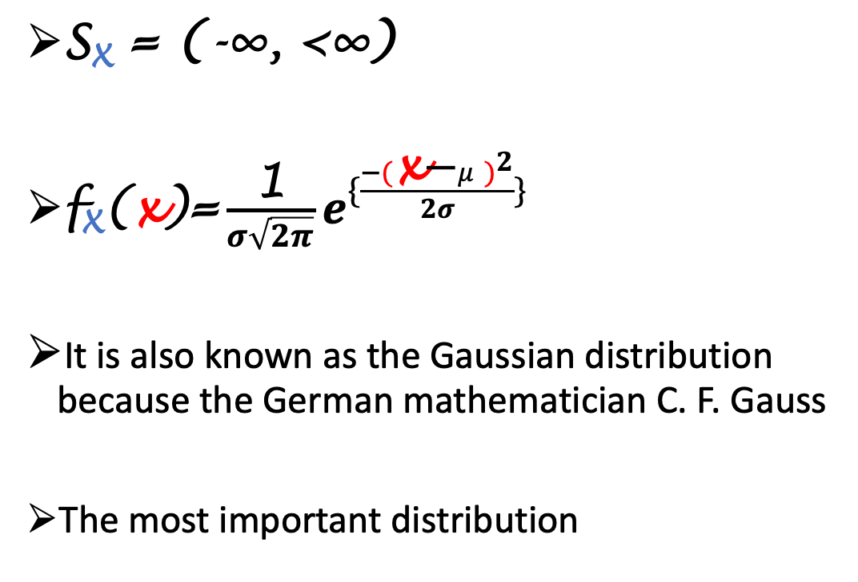

Normal distribution
f_{X}(x)
S_{X} = (-∞, <∞)
$\text{f}\text{X}\text{(}\text{x}\text{)}\text{=}\frac{\text{1}}{σ\sqrt{2π}}e^{\{\frac{−{(\text{x}\text{−}μ)}^{2}}{2σ}\}}$
﻿It is also known as the Gaussian distribution because the German mathematician C. F. Gauss
﻿The most important distribution
x
$$μ$$
﻿the way particles of smoke dissipate in a closed room
﻿journey of a bottle floating in the ocean
﻿the white noise of cosmic background radiation
Statistical data analysis in R. Viktor Ermakov – Visiting professor, UFSCar.

Slide 14
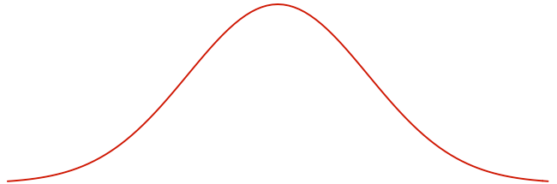
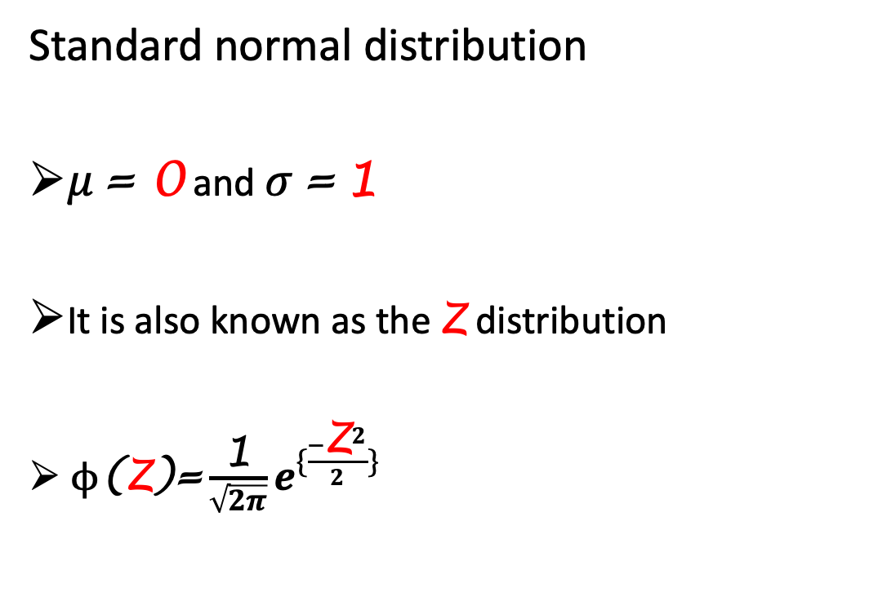
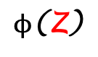
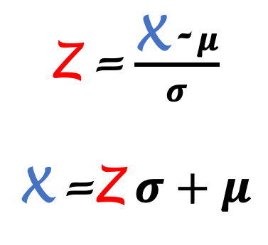
Normal distribution
f_{X}(x)
$ϕ$($\text{Z}$)
Standard normal distribution
$μ \text{=} \text{0}$ and $σ \text{=}$1
﻿It is also known as the Z distribution
﻿ $ϕ\text{(}\text{Z}\text{)}\text{=}\frac{\text{1}}{\sqrt{2π}}e^{\{\frac{−{\text{Z}}^{2}}{2}\}}$
x
$$μ$$
-3
-2
-1
0
1
2
3
68%
$\text{Z}$ = $\frac{\text{X}\text{-} μ}{σ}$
$\text{X}$ =$\text{Z} σ+μ$
95%
99,7%
68–95–99.7 rule
Statistical data analysis in R. Viktor Ermakov – Visiting professor, UFSCar.

Slide 15
Waiting time distributions
When the random variable represents time until a certain event occurs
time before the manufactured product fails
time between costumers in a retail store
Exponential distribution
Gamma distribution
Statistical data analysis in R. Viktor Ermakov – Visiting professor, UFSCar.

Slide 16
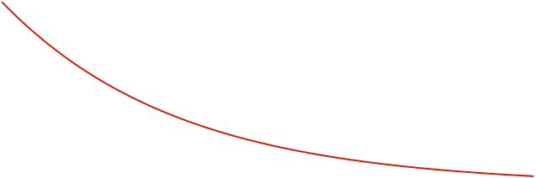

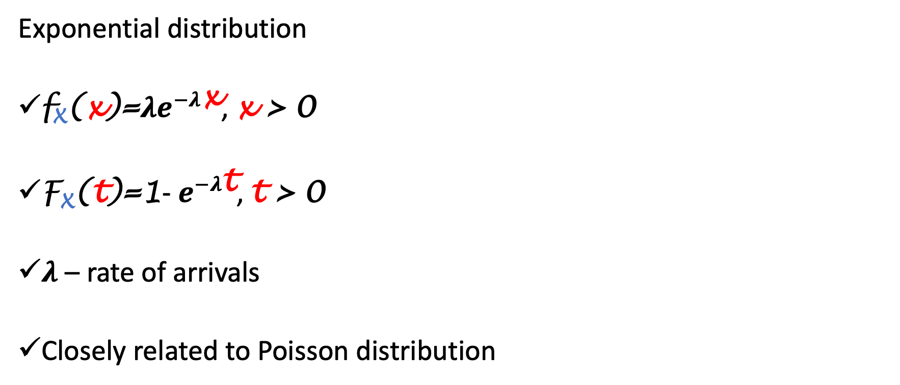
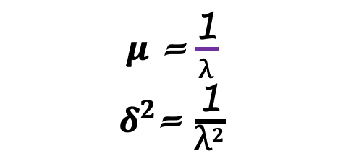
Waiting time distributions
Exponential distribution
$\text{f}\text{X}\text{(}\text{x}\text{)}\text{=}λe^{−λ\text{x}}$, x > 0
$\text{F}\text{X}\text{(}\text{t}\text{)}\text{=}\text{1}\text{-}{ e}^{−λ\text{t}}$, t > 0
$λ$ – rate of arrivals
Closely related to Poisson distribution
f_{X}(x)
x
$$0$$
$μ$ =$\frac{\text{1}}{λ}$
$δ^{2}$= $\frac{\text{1}}{{\text{λ}}^{2}}$
“﻿memoryless”
Statistical data analysis in R. Viktor Ermakov – Visiting professor, UFSCar.

Slide 17
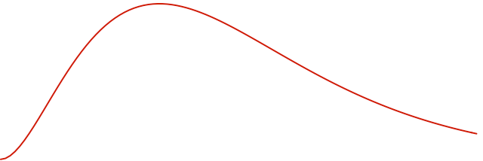
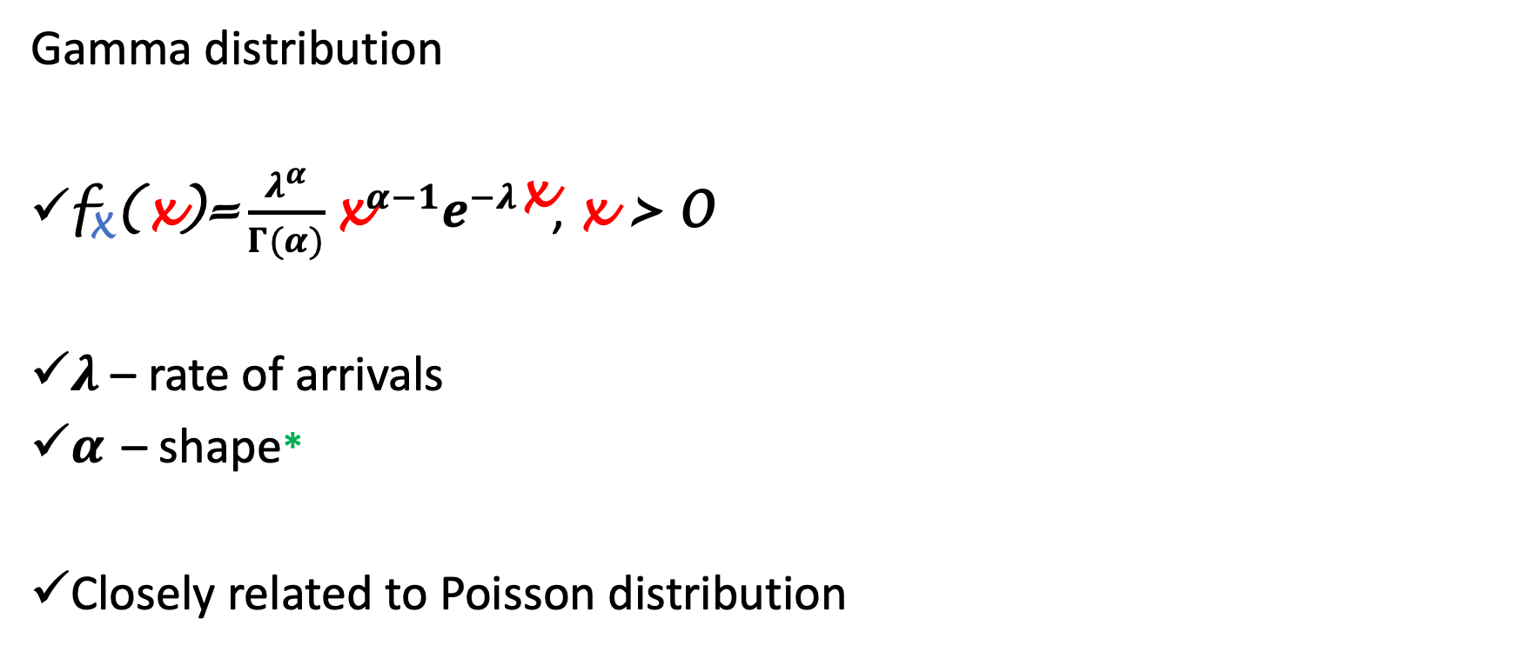

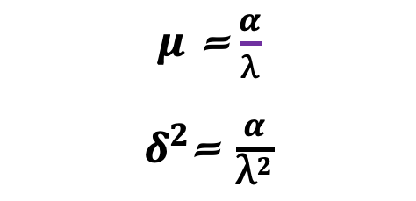
Waiting time distributions
Gamma distribution
$\text{f}\text{X}\text{(}\text{x}\text{)}\text{=}\frac{λ^{α}}{Γ(α)}{\text{x}}^{α−1}e^{−λ\text{x}}$, x > 0
$λ$ – rate of arrivals
$α$ – shape*
Closely related to Poisson distribution
f_{X}(x)
x
$$0$$
$μ$ =$\frac{α}{λ}$
$δ^{2}$= $\frac{α}{{\text{λ}}^{2}}$
* When $α$ is an integer the distribution is known as Erlang distribution
Statistical data analysis in R. Viktor Ermakov – Visiting professor, UFSCar.

Slide 18
Three important distributions
There are three important distributions used in inferential statistics
hypothesis testing
constructing confidential intervals
Student’s t distribution
𝜒² (chi-square) distribution
Snedecor’s F distribution
Statistical data analysis in R. Viktor Ermakov – Visiting professor, UFSCar.

Slide 19
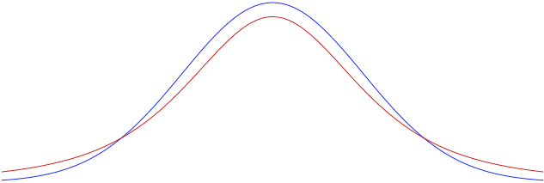
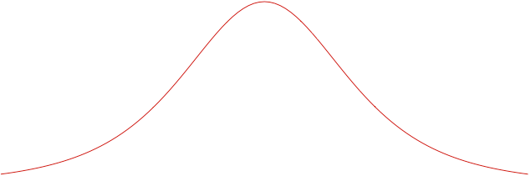
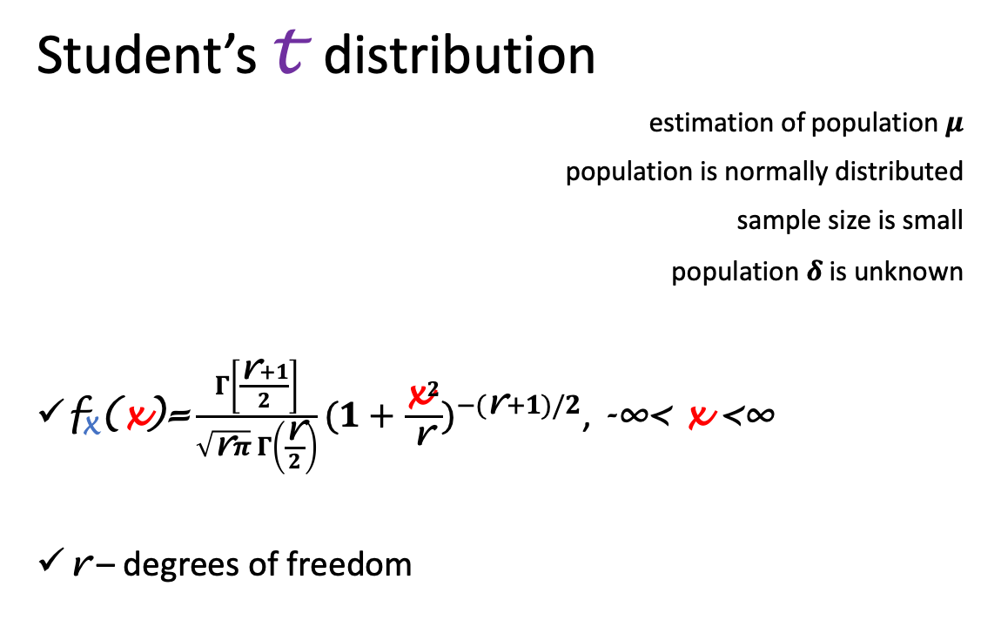
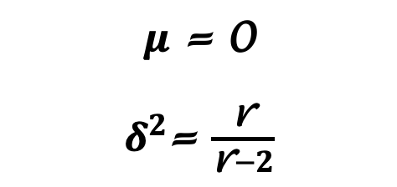
Three important distributions
Student’s t distribution
estimation of population $μ$
population is normally distributed
sample size is small
population $δ$ is unknown
$\text{f}\text{X}\text{(}\text{x}\text{)}\text{=}\frac{Γ\left[\frac{\text{r}+1}{2}\right]}{\sqrt{\text{r}π} Γ\left(\frac{\text{r}}{2}\right)}{(1+\frac{{\text{x}}^{2}}{\text{r}})}^{−(\text{r}+1)/2}$, -∞< x <∞
r – degrees of freedom
f_{X}(x)
x
0
$μ$ = 0
$δ^{2}$= $\frac{\text{r}}{\text{r}−2}$
similar to Z distribution but has heavier tails
r→∞ ➭ t→ Z
Statistical data analysis in R. Viktor Ermakov – Visiting professor, UFSCar.

Slide 20
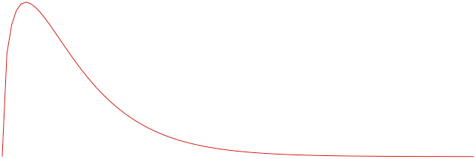
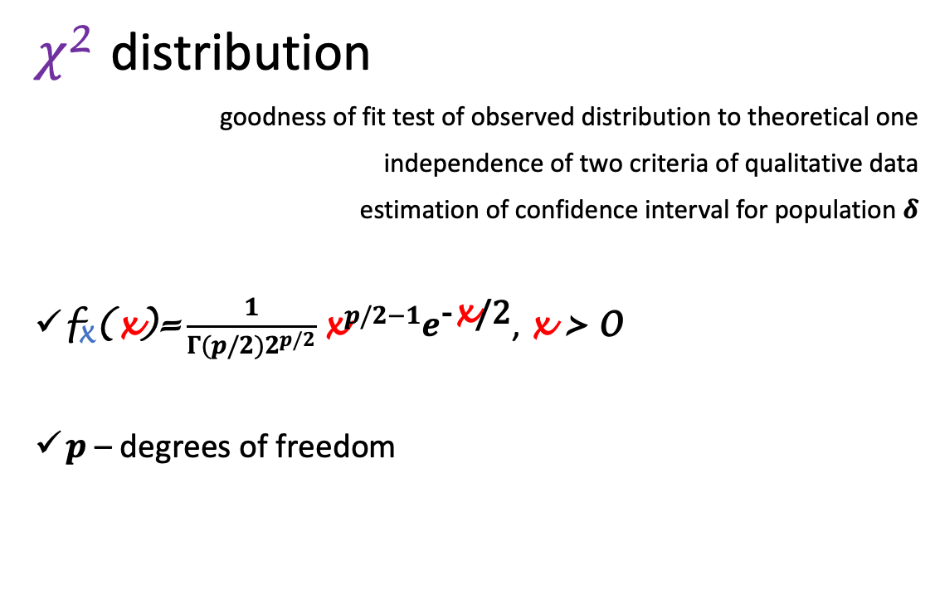
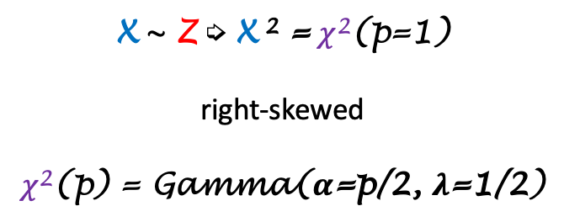
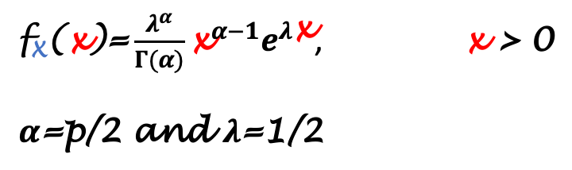
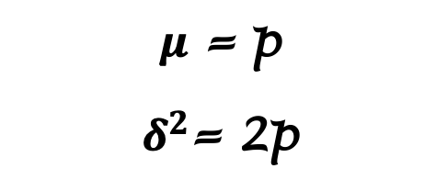
Three important distributions
𝜒² distribution
goodness of fit test of observed distribution to theoretical one
independence of two criteria of qualitative data
estimation of confidence interval for population $δ$
$\text{f}\text{X}\text{(}\text{x}\text{)}\text{=}\frac{1}{Γ(p/2)2^{p/2}}{\text{x}}^{p/2−1}e^{\text{-}\text{x}\text{/2}}$, x > 0
$p$ – degrees of freedom
f_{X}(x)
x
$$0$$
$\text{f}\text{X}\text{(}\text{x}\text{)}\text{=}\frac{λ^{α}}{Γ(α)}{\text{x}}^{α−1}e^{λ\text{x}}$, x > 0
$α$=p/2 and $λ$=1/2
$μ$ = p
$δ^{2}$= 2p
X ~ Z ➭ X ² = 𝜒²(p=1)
right-skewed
𝜒²(p) = Gamma($α$=p/2, $λ$=1/2)
Statistical data analysis in R. Viktor Ermakov – Visiting professor, UFSCar.

Slide 21
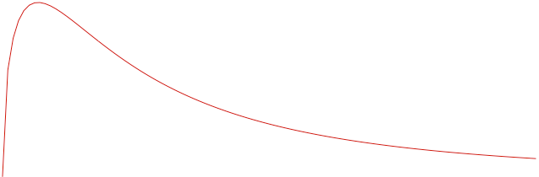
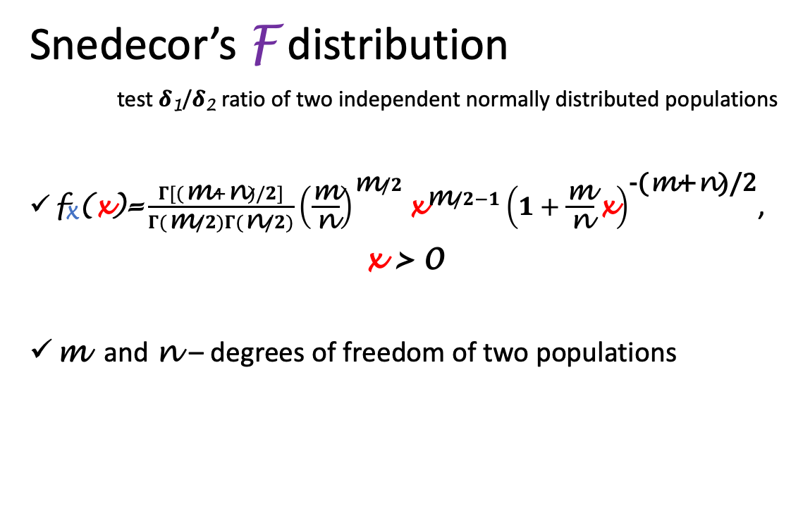
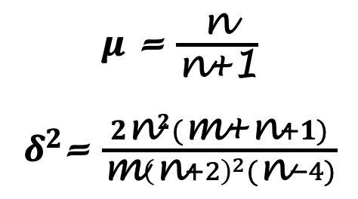
Three important distributions
Snedecor’s F distribution
test 𝜹₁/𝜹₂ ratio of two independent normally distributed populations
$\text{f}\text{X}\text{(}\text{x}\text{)}\text{=}\frac{Γ[(\text{m}+\text{n})/2]}{Γ(\text{m}/2)Γ(\text{n}/2)}{\left(\frac{\text{m}}{\text{n}}\right)}^{\text{m}/2}{\text{x}}^{\text{m}/2−1}{\left(1+\frac{\text{m}}{\text{n}}\text{x}\right)}^{\text{-(}\text{m}\text{+}\text{n}\text{)}\text{/2}}$,
x > 0
m and n – degrees of freedom of two populations
f_{X}(x)
x
$$0$$
$μ$ = $\frac{\text{n}}{\text{n}\text{+1}}$
$δ^{2}$= $\frac{2{\text{n}}^{2}(\text{m}\text{+}\text{n}+1)}{\text{m}{\left(\text{n}+2\right)}^{2}(\text{n}−4)}$
X ~F(m , n) ➭ 1/X ~F(n , m )
X ~ t(r) ➭ X² ~F(1 , r)
Statistical data analysis in R. Viktor Ermakov – Visiting professor, UFSCar.

Slide 22
Other popular distributions
Cauchy distribution
X ₁/ X ₂ of two independent normally distributed populations
Beta distribution
used in Bayesian statistics to model prior beliefs
Logistic distribution
used for modelling continuous variables in linear regression
Lognormal distribution
used when a random variable is a product of positive normally distributed random variables
Weibull distribution
describe a particle size distribution
Statistical data analysis in R. Viktor Ermakov – Visiting professor, UFSCar.

Slide 23
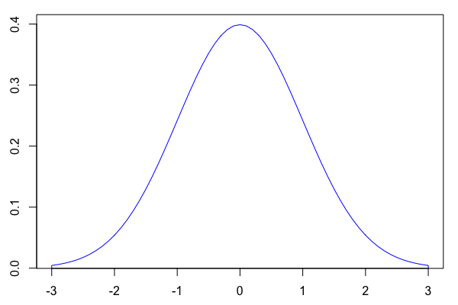
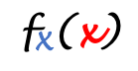

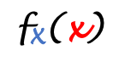

Distribution functions in R
There are 4 functions associated with a particular distribution in R:
$$\text{f}\text{X}\text{(}\text{x}\text{)}\text{=}\frac{\text{1}}{σ\sqrt{2π}}e^{\{\frac{−{(\text{x}\text{−}μ)}^{2}}{2σ}\}}$$
Normal distribution
$$\text{f}\text{X}\text{(}\text{x}\text{)}$$
$$\text{x}$$
d
p
q
r
norm(x, mean=0, sd=1)
$$\text{f}\text{X}\text{(}\text{x}\text{)}$$
0.1295176
x
1.5
Statistical data analysis in R. Viktor Ermakov – Visiting professor, UFSCar.

Slide 24
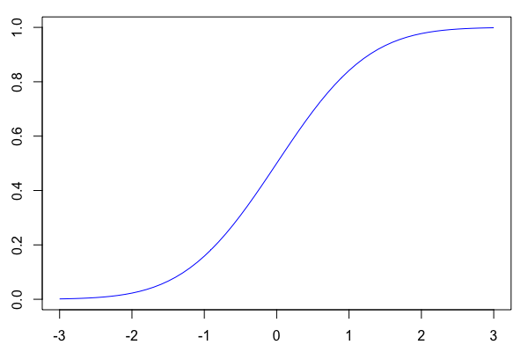
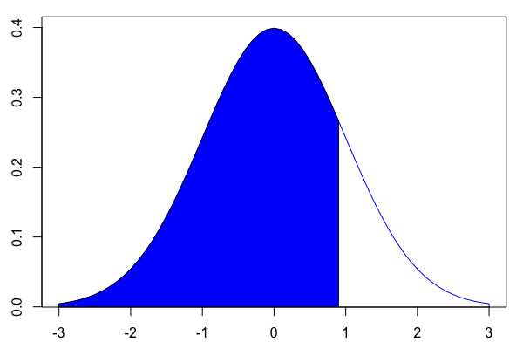
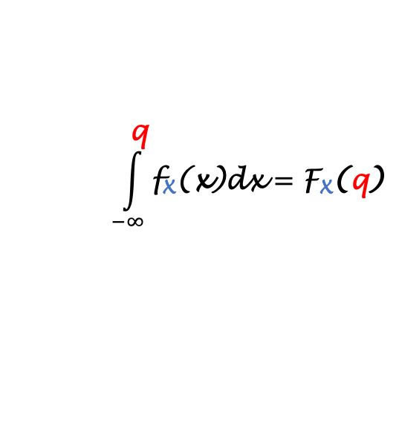
Distribution functions in R
There are 4 functions associated with a particular distribution in R:
$$\int_{−∞}^{\text{q}}{\text{f}\text{X}\text{(}\text{x}\text{)}\text{dx}}=\text{F}\text{X}\text{(}\text{q}\text{)}$$
Cumulative Distribution Function - F_{X}(x)
Probability Density Function - f_{X}(x)
Normal distribution
$$\text{f}\text{X}\text{(}\text{x}\text{)}$$
0.8159399
F_{X}(x)
d
p
q
r
norm(x, mean=0, sd=1)
norm(q, mean=0, sd=1)
F_{X}(q)
q
0.9
Statistical data analysis in R. Viktor Ermakov – Visiting professor, UFSCar.

Slide 25
Distribution functions in R
There are 4 functions associated with a particular distribution in R:
$$\int_{−∞}^{\text{q}}{\text{f}\text{X}\text{(}\text{x}\text{)}\text{dx}}=\text{F}\text{X}\text{(}\text{q}\text{)}$$
Cumulative Distribution Function - F_{X}(x)
Normal distribution
0.8159399
d
p
q
r
norm(x, mean=0, sd=1)
pnorm
norm(q, mean=0, sd=1)
norm(p, mean=0, sd=1)
qnorm
0.9
Statistical data analysis in R. Viktor Ermakov – Visiting professor, UFSCar.

Slide 26
Distribution functions in R
There are 4 functions associated with a particular distribution in R:
$$\int_{−∞}^{\text{q}}{\text{f}\text{X}\text{(}\text{x}\text{)}\text{dx}}=\text{F}\text{X}\text{(}\text{q}\text{)}$$
Cumulative Distribution Function - F_{X}(x)
Normal distribution
0.8159399
d
p
q
r
norm(x, mean=0, sd=1)
pnorm
norm(q, mean=0, sd=1)
norm(p, mean=0, sd=1)
norm(n, mean=0, sd=1)
qnorm
set.seed(seed)
0.9
Statistical data analysis in R. Viktor Ermakov – Visiting professor, UFSCar.

Slide 27
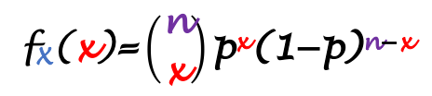
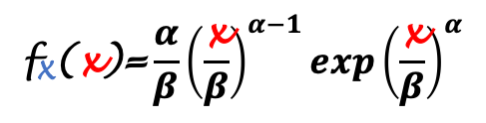
Distribution functions in R
$$\int_{−∞}^{\text{q}}{\text{f}\text{X}\text{(}\text{x}\text{)}\text{dx}}=\text{F}\text{X}\text{(}\text{q}\text{)}$$
$$\text{f}\text{X}\text{(}\text{x}\text{)}\text{=}\left({\text{n} \atop \text{x}}\right)\text{p}\text{x}\text{(1−}\text{p}\text{)}\text{n}\text{−}\text{x}$$
$$\text{f}\text{X}\text{(}\text{x}\text{)}\text{=}\frac{α}{β}{\left(\frac{\text{x}}{β}\right)}^{α−1}exp{\left(\frac{\text{x}}{β}\right)}^{α}$$
Binomial distribution
Weibull distribution
Normal distribution
d
p
q
r
dweibull(x, shape, scale=1)
pweibull(q, shape, scale=1)
qweibull (p, shape, scale=1)
rweibull (n, shape, scale=1)
dbinom(x, size, prob)
pbinom(q, size, prob)
qbinom(p, size, prob)
rbinom(n, size, prob)
norm(x, mean=0, sd=1)
norm(q, mean=0, sd=1)
norm(p, mean=0, sd=1)
norm(n, mean=0, sd=1)
help(Distributions)
Statistical data analysis in R. Viktor Ermakov – Visiting professor, UFSCar.

